Slide 1
Creating a PowerShell Toolkit to Demystify DSC
aka: Creating a Custom PowerShell Toolkit to Demystify the Intricacies of Desired State Configuration

Slide 2

Get-Help –Name ‘about_Presenter’
Mike F Robbins
Microsoft MVP on Windows PowerShell
SAPIEN Technologies MVP
Leader & Co-Founder of the Mississippi PowerShell User Group
Co-Author of Windows PowerShell TFM 4th Edition
Author of Chapter 6 in the PowerShell Deep Dives book
Winner of the Advanced Category in the 2013 Scripting Games
Learn more about me @ mikefrobbins.com

Slide 3
Write-Output ‘Questions for Audience’
IT Pro’s
Developers
PowerShell version 4 or higher
Functions
Modules
Desired State Configuration
PKI (Public Key Infrastructure)
Source Control
Unit Testing via Pester
Job Responsibilities

Slide 4
Set-Content ‘Information to Cover’
DSC (Desired State Configuration)
LCM (Local Configuration Manager)
Push Mode
Pull Mode
DSC Resources
New DSC Features in PowerShell version 5
Functions
Modules
Toolmaking
Automation

Slide 5

Start-Process ‘Demo’

Slide 6
Celebrating 10 Years of PowerShell 2006 - 2016
Jeffrey Snover
Kenneth Hansen
Lee Holmes
Narayanan Lakshmanan
Hemant Mahawar
Bruce Payette
Hitesh Raigandhi
Dan Travison
Jim Truher
Krishna Vutukuri
Congratulations to the team members who’ve been there since the beginning…
...and thanks for all the great work!

Slide 7
Select-Object –Property ‘Resources’
Free:
PowerShell.org
Microsoft Virtual Academy
SAPIEN Technologies
PowerShell Magazine
User Groups
Twitter
GitHub
Reddit
Blogs
Paid:
Windows Desired State Configuration Revealed book
Learning PowerShell DSC book
Pluralsight

Slide 8
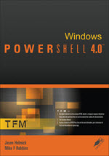
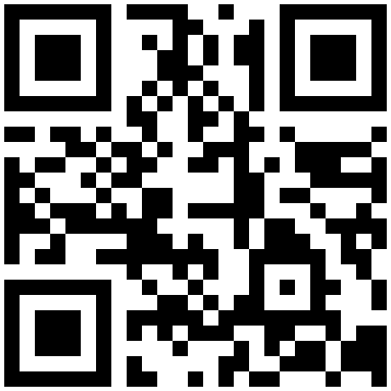

Get-Contact –Identity ‘Presenter’
Blog: mikefrobbins.com (or MrPowerShell.com)
Twitter: @mikefrobbins
LinkedIn: www.linkedin.com/in/mikefrobbins
Email: See mikefrobbins.com/about/
User Group: mspsug.com (or MsPowerShell.com)

